Slide 1
Sensors to perceive the environment
Md. Khalilur Rhaman
Associate Professor
CSE Department
BRAC University

Slide 2
Hardware Calibration
Processor can read either digital or Analog value
Digital should be “0” (Gnd) or “1” (>3.5 Volt)
Analog should be in a range according to the analog reference voltage (Usually 0 volt to 5 volt).
Analog Voltage 🡪 ADC 🡪 Numerical Value (Usually 0 to 255 (8 bit Binary Nmber))
So, a sensor input must be calibrated into a readable range of Processor with a circuit.

Slide 3
Hardware Calibration Block Diagram
Power +12 v
Sensor
Hardware Calibration Circuit
Processor Readable Range (0 to 5 volt)
GND
To get efficient result, hardware Calibration should be in the way so that the lower value goes to lower range and upper value goes to upper range.

Slide 4
Sensors
By Material
Thermistor
Piezoelectric
Pyro electric material (IR)
Electromagnetic
Semiconductor
Radio active material
Capacitive
Resistive
Conductive
By Engineering
Gyroscope
Microphone
Camera
LiDAR
Pulse Oximeter
Level Sensor
Hall-effect
Break-Beam
Vibrator
Accelarometer

Slide 5
Sensors
Active Sensor:
Requires emitter
Passive Sensor:
Sense environment directly. No need to emit any signal.

Slide 6
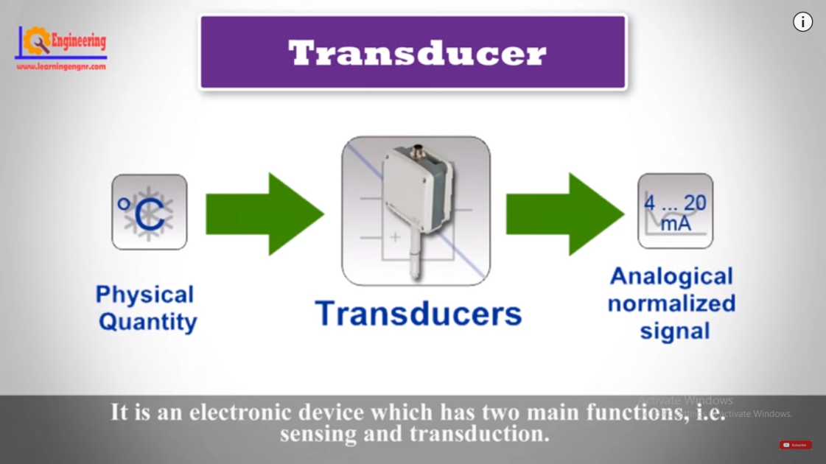
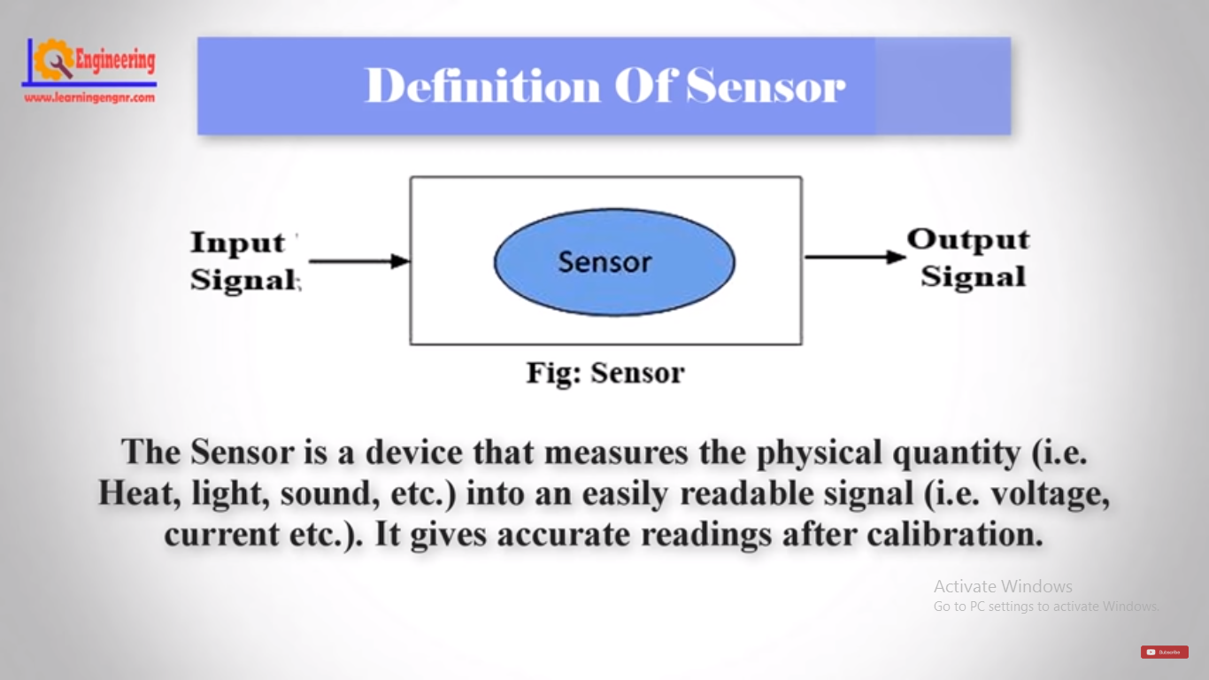
Transducer & Sensor
Transducer: Convert energy from one form to another
Pressure, Piezoelectric, Ultra-sound, Temperature
Sensor: Detect physical quantity and convert into electrical Signal

Slide 7
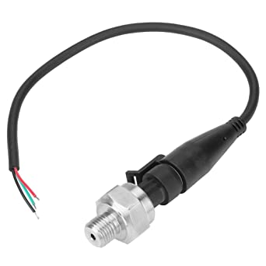
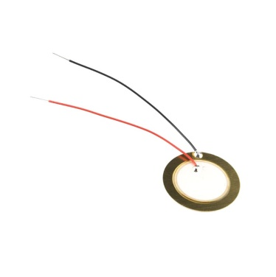
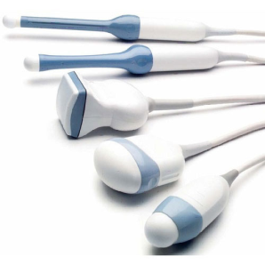
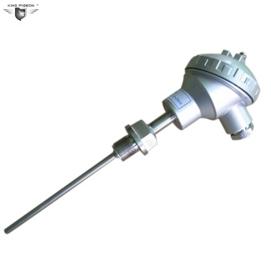
Transducer
Pressure (Refrigerator and AC)
Piezoelectric (Buzzer or lighter)
Ultra-sound (Ultrasonography, Sonar)
Temperature (Engines and boilers)

Slide 8
Sensors
Light based Sensors
Magnetic & Electro-Magnetic sensor
Sound based Sensors
Some Modern Sensors
Water conductivity based sensors
Underwater Sensors

Slide 9
Sensors
Light based Sensors
Camera
Infrared
LDR
X-Ray
UV Ray
Heartbeat Sensor
Laser Sensor
Magnetic & Electro-Magnetic sensor
Reed Switch
Hall-Effect based Sensors
Electromagnetic
Sound based Sensors (using transducer or Piezoelectricity)
Microphone
Ultra-Sonic
Pressure
Vibration

Slide 10
Light based Sensors
Camera
Infrared
LDR
X-Ray
UV Ray
Heartbeat Sensor
Laser Sensor

Slide 11
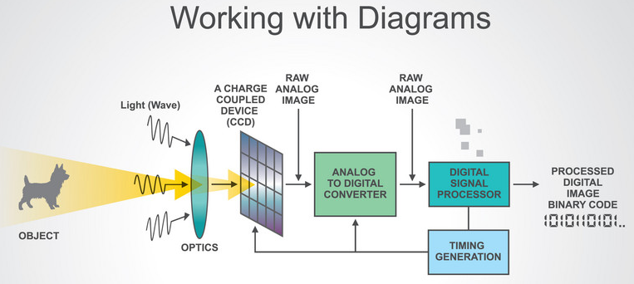
Camera

Slide 12
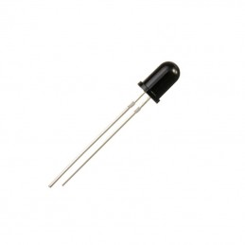
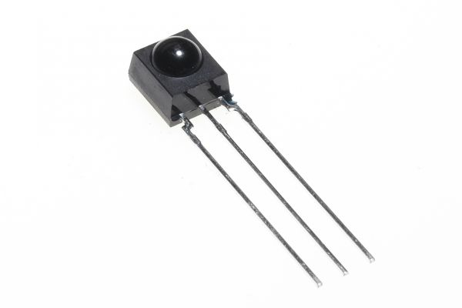
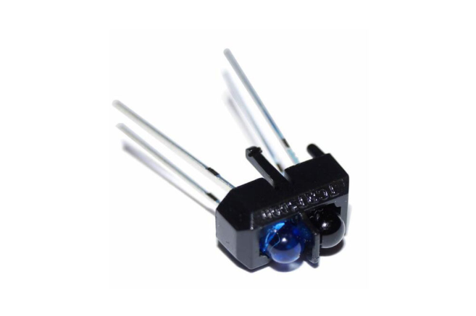
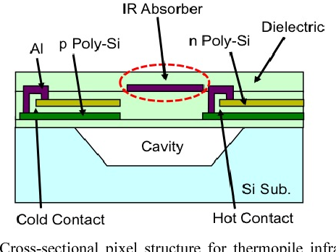
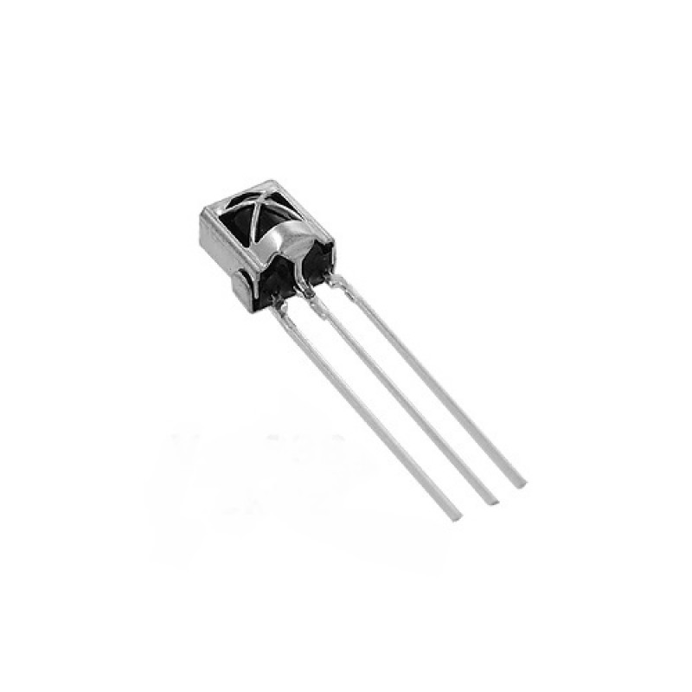
IR Sensor
Composed of Pyro electric material: Pyro electricity can be described as the ability of certain materials to generate a temporary voltage when they are heated or cooled.)

Slide 13
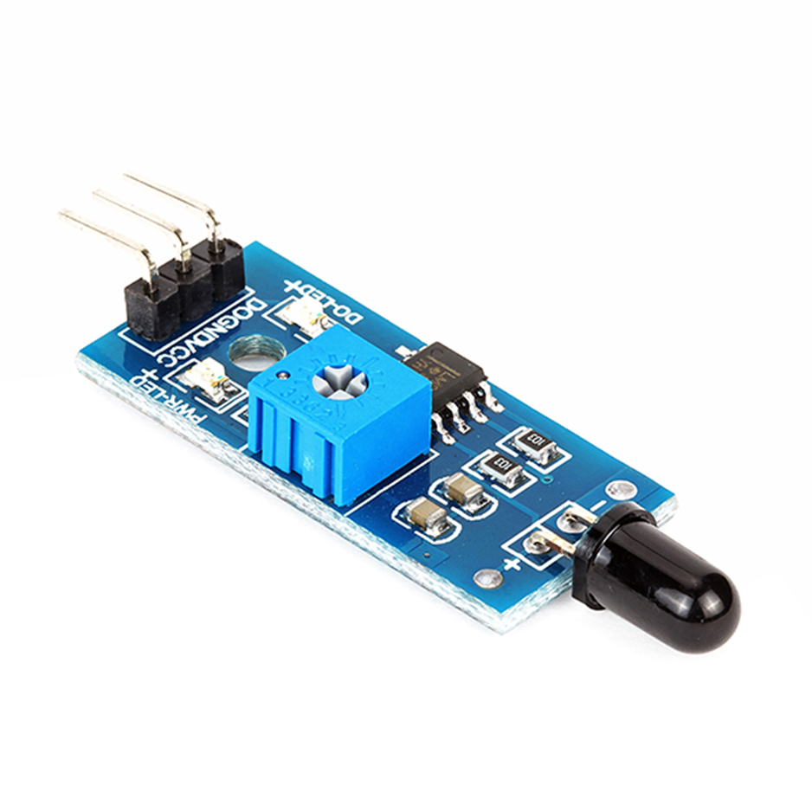
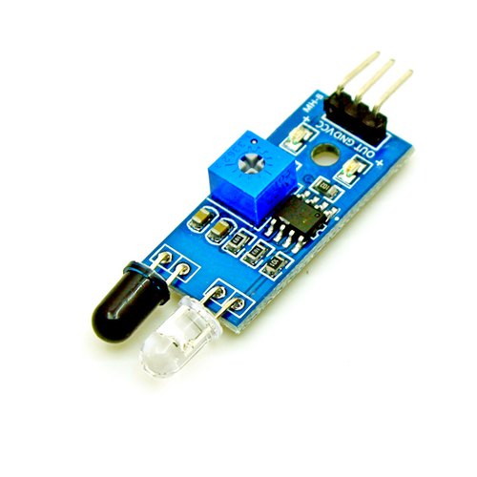
IR detector & Flame Sensor Module

Slide 14
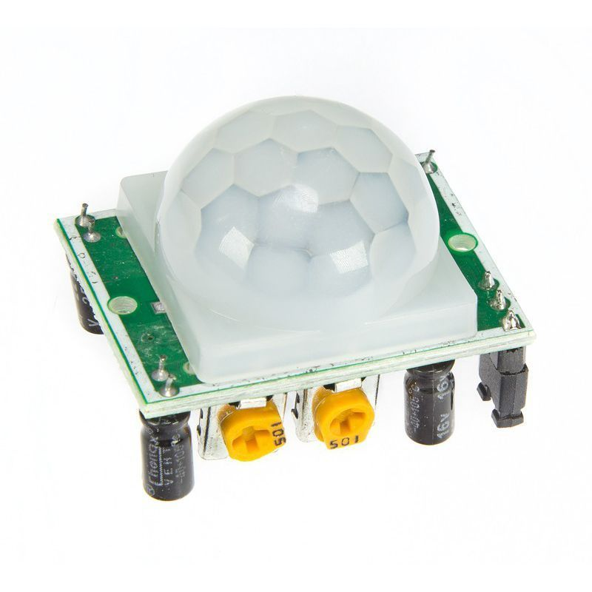
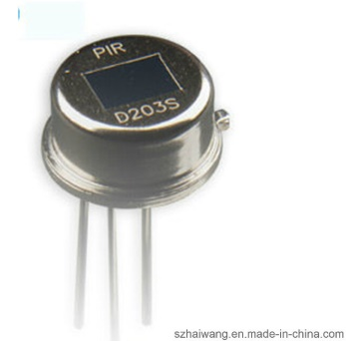
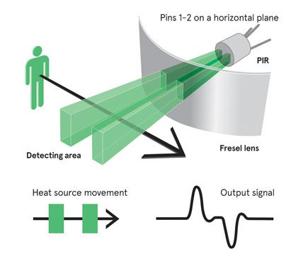
PIR
Passive InfraRed sensor
Fresnel lenses used to focus the heat onto the material.
PIR need stabilizing period to adjust the room temperature
When human or animal passes heat increased and stabilized again.

Slide 15
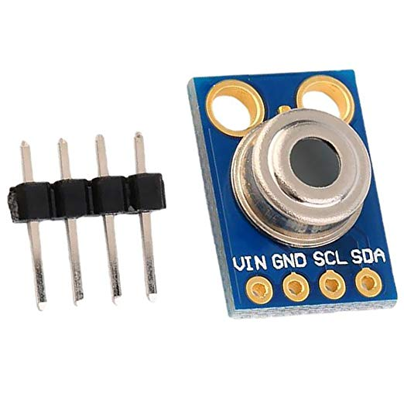
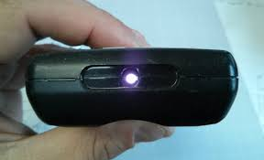
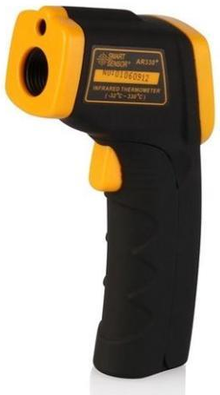
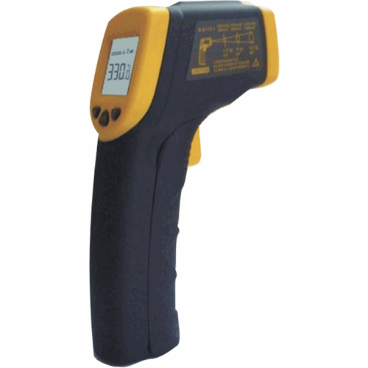
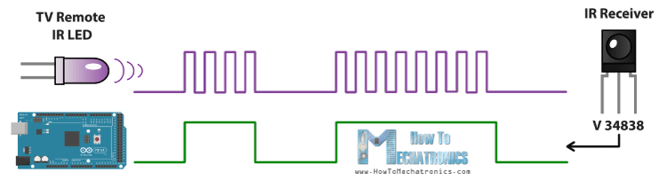
Infrared in Temperature Sensor and TV Remote

Slide 16
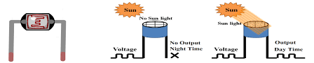
LDR
Use Photo Sensitive Semi-conductor material

Slide 17
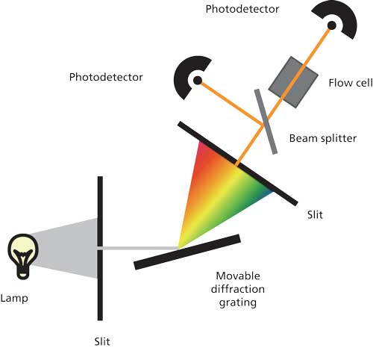
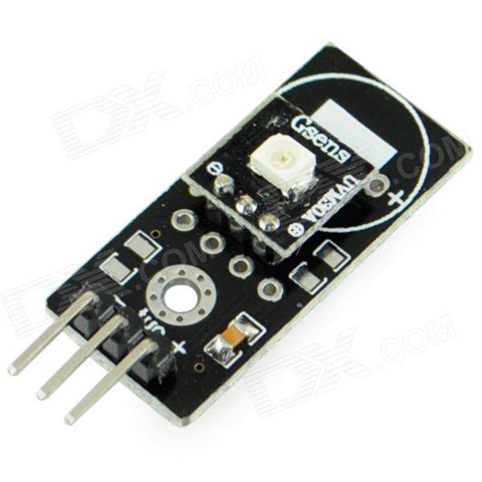
UV Sensor Module
Response wavelength: 200~370nm

Slide 18
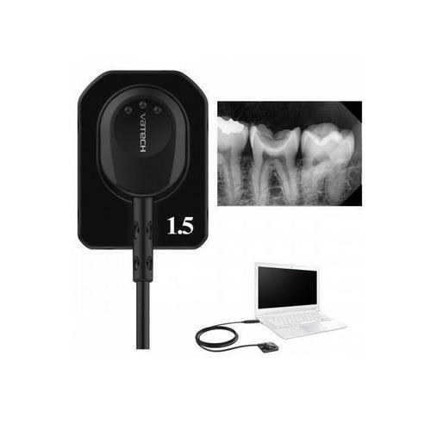
X-Ray Sensor

Slide 19
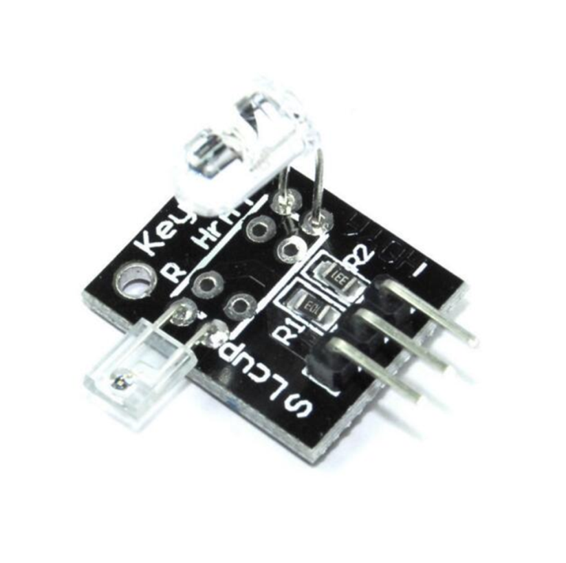
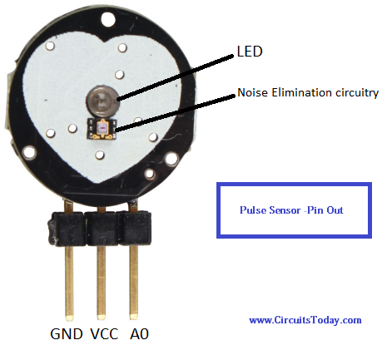
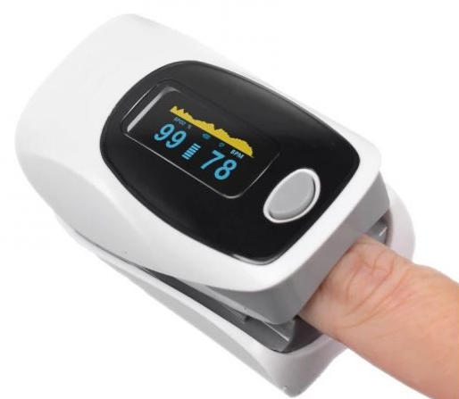
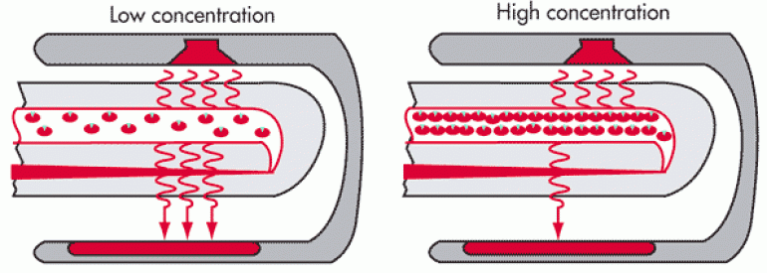
Pulse Oximeter using light and IR

Slide 20
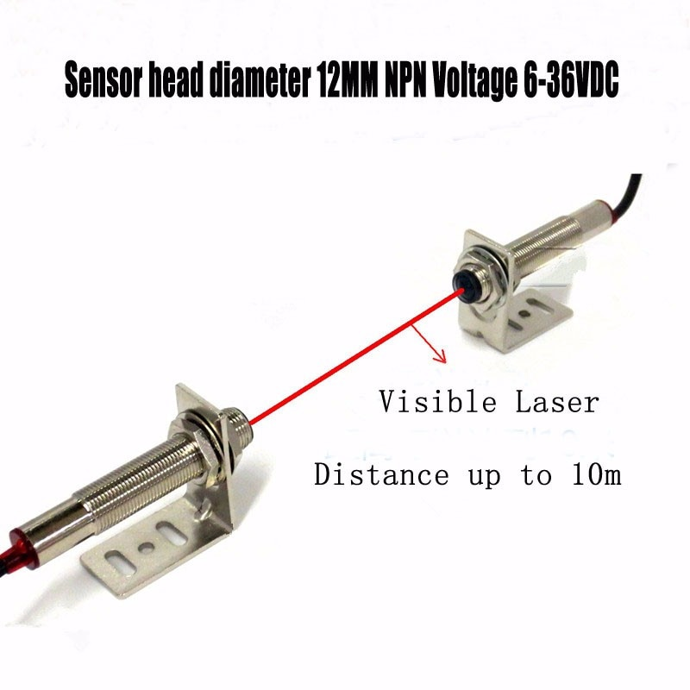
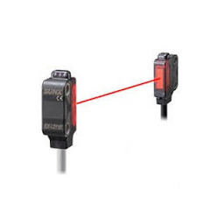
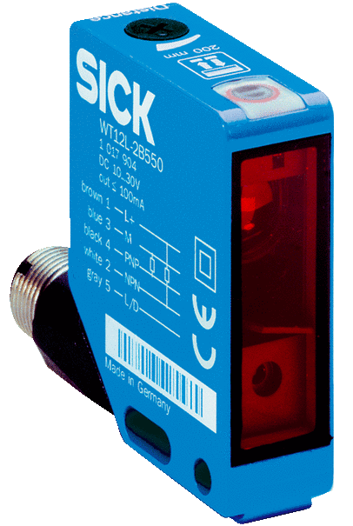
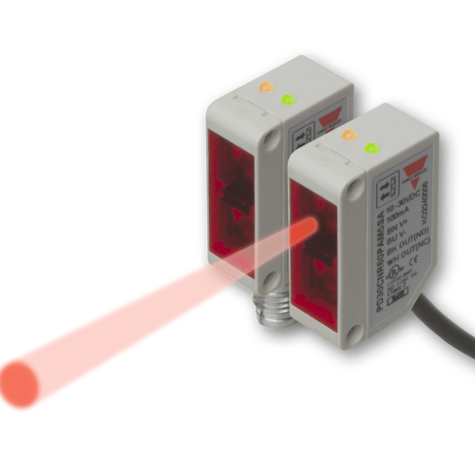
Laser Sensor

Slide 21
Magnetic & Electro-Magnetic sensor
Reed Switch
Hall-Effect based Sensors
Electro-Magnetic Sensor

Slide 22
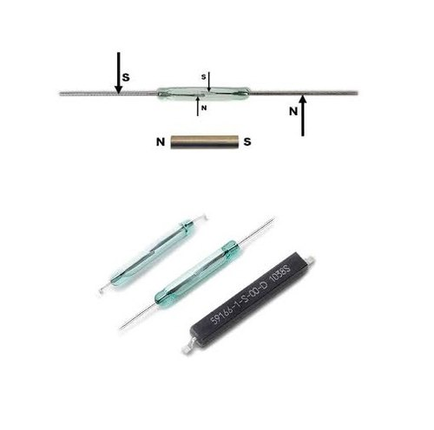
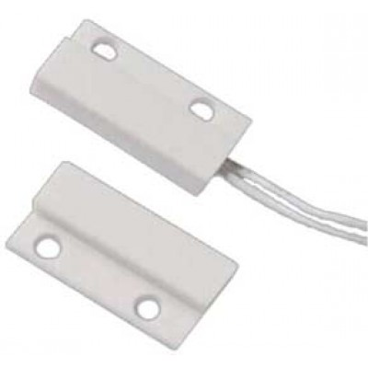
Magnetic Type Sensor (Mini Magnetic or Reed Switch)

Slide 23
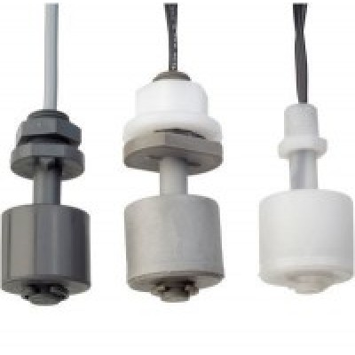
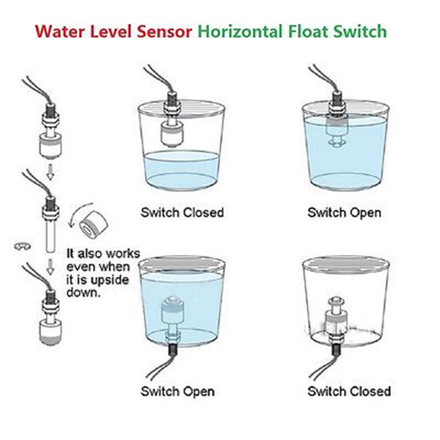
Liquid Level Sensor using reed switch

Slide 24
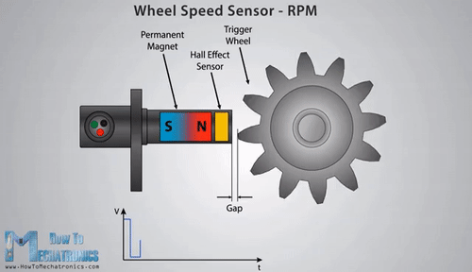
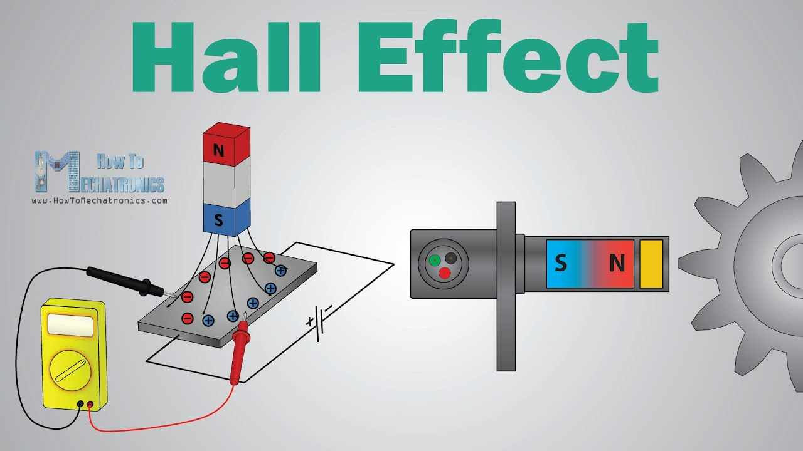
Hall Effect

Slide 25
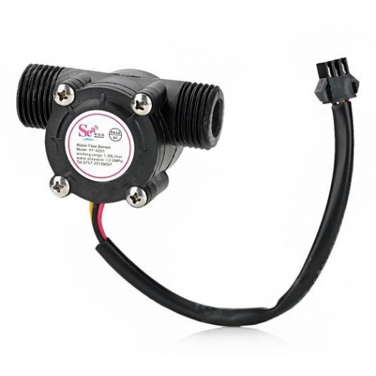
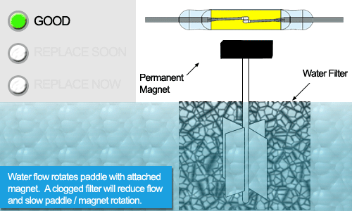
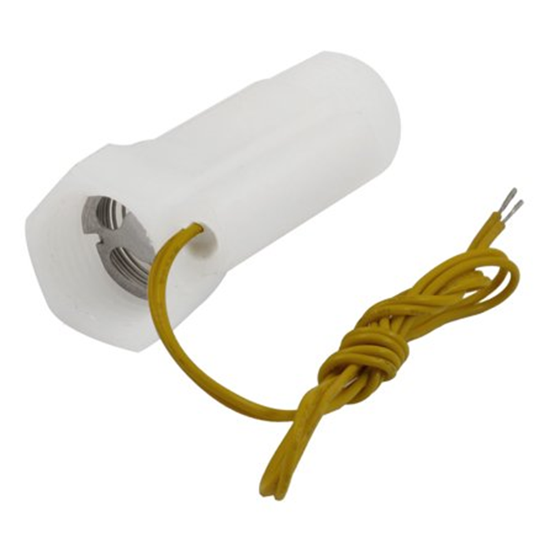
Water Flow Sensor using both reed switch and Hall effect

Slide 26
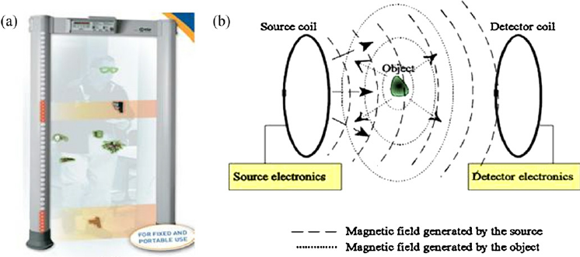
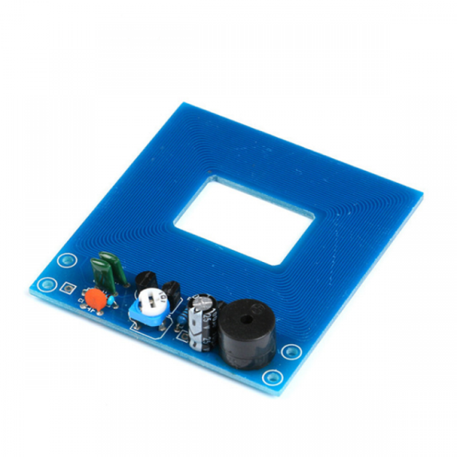
Metal Detector using Hall-effect

Slide 27
Sound based Sensor
By using Transducer or Magnetic Flux
By using Piezoelectric
Microphone
Ultra-Sonic
Pressure
Vibration

Slide 28
Piezoelectric Materials
Natural piezoelectric occurring materials:
Berlinite (structurally identical to quartz)
Cane sugar
Quartz (SiO₂)
Rochelle salt
Topaz
Tourmalin
Dry bone
Man-made piezoelectric materials:
Barium titanate
Lead zirconate titanate.

Slide 29
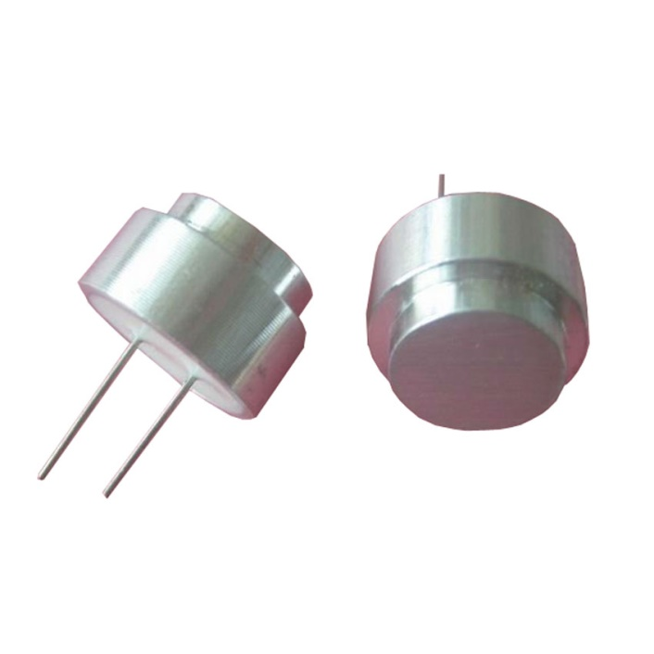
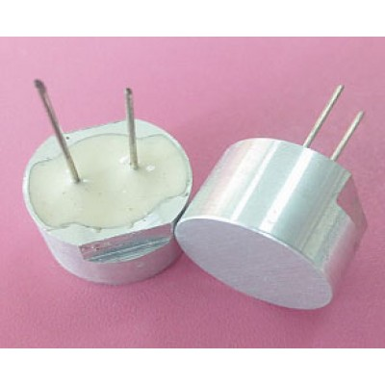
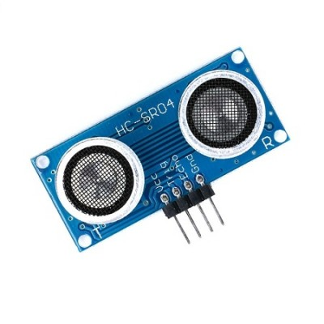
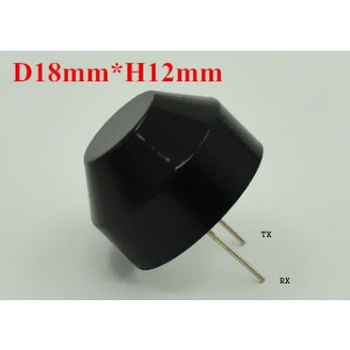
Ultrasonic
By using travelling time of a ultrasonic wave with frequency of 40khz
Distance = (Speed X Time)/2
Speed of ultrasonic wave is: 340meter/second in air

Slide 30
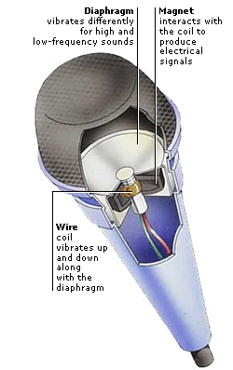

SOUND SENSOR (microphone)

Slide 31



Vibration Sensor (Using Piezo)

Slide 32


Pressure Sensor
Pressure of gas and liquid.

Slide 33
Modern Sensors
Temperature
Proximity
Smoke & Gas
Voltage Sensor
Humidity Sensor
Touch Sensor
Gyroscope
Accelerometer
Break-Beam
LiDAR

Slide 34

https://www.youtube.com/watch?v=xvF8b3eKelU
https://youtu.be/4mQ3o1t4Ssg
https://www.youtube.com/watch?time_continue=2&v=4mQ3o1t4Ssg&feature=emb_logo

Slide 35


Temperature Sensing
Resistance Temperature Detector (RTD): Platinum, Copper, Nickel, Nickel-Ion
Thermocouple (TC): Junction of two materials (Iron-constantan, Cromel-Alimel)

Slide 36




Temperature Sensing
Thermistor are temperature dependent resister
PTC (Positive Temperature Coefficient)
Self regulating Heating Element
Negative Temperature Coefficient NTC
Semiconductor based temperature sensor used inside IC
RTD resistors are pure metal and thermistors are made with polymer or ceramic materials

Slide 37

Types of Proximity Sensors
https://www.youtube.com/watch?v=xAiSuQK22IM

Slide 38



Proximity Sensors
Inductive:
Measure metal magnetic field from induction coil
Capacitive:
Measures metallic and non-metallic objects (Liquids, plastics, woods etc.)

Slide 39






Other ways of proximity sensing
Photoelectric:
Magnetic:
Inductive:
IR
Laser

Slide 41



Microwave Proximity Sensor (for moving object)
Using “Doppler Effect” of moving object

Slide 42



Smoke Detector
Radio active material: Americium-241

Slide 43

Smoke and Gas Sensor
Materials: metal oxides, semiconductors, carbon-based materials, and conducting polymers etc. Example: (Cami resistance / Carbon nano-tube)
1. Gas Sensor (MQ-9)
2. Smoke Sensor (MQ-5)
3. MQ135 Air Quality Sensor module
4. MQ6 LPG, LNG, iso-butane, propane gas
5. MQ8 Hydrogen gas sensor Module

Slide 44


Voltage Sensor

Slide 45


Humidity Sensor

Slide 46



Touch Sensor

Slide 47

Accelerometer

Slide 48



Accelerometer

Slide 49



Gyroscope

Slide 50




Break beam sensor (Shaft/Rotary encoder)

Slide 51




Break beam sensor (Light curtain (Lift door))

Slide 52



LiDAR (Light Detection And Ranging)

Slide 53

Laser Scanner or Lidar

Slide 54
Water and Underwater Sensors
Water Conductivity based sensor
Steam
Rain
water level
Soil Moisture Sensor
Underwater Sensor:
Ph and Alkalinity
Dissolved Oxygen Sensor (DO)
Biochemical Oxygen Demand (BOD)
BOD, COD, TSS
Total Dissolved Solids S and Turbidity
Chlorine
Electrical Conductivity sensor water

Slide 55

Water Level sensor

Slide 56

Rain Sensor

Slide 57

Steam Sensor

Slide 58

Soil Moisture Sensor

Slide 59

Ph and Alkalinity

Slide 60

Dissolved Oxygen Sensor (DO)

Slide 61

Biochemical Oxygen Demand (BOD)

Slide 62

BOD, COD, TSS
BOD: Biochemical Oxygen Demand
COD: Chemical Oxygen Demand
TSS: Turbidity And Total Suspended Solids
http://onlineeffluentmonitoring.com/bodcodtss/

Slide 63

Total Dissolved Solids S and Turbidity

Slide 64

Chlorine

Slide 65

Electrical Conductivity sensor water

